Slide 1
Search and Rescue
Mission Two

Slide 2
Factors
Aircraft’s emergency locator transmitter did not activate
Several anomalies exist on the map
One of them is the downed aircraft
There may be multiple survivors
Survivors may have relocated
Survivors could have split up
Survivors could be injured or unconscious after relocation

Slide 3
The ‘4S’ Procedure
Scout anomalies to find crash site
Start transceiver (transmitter receiver) distribution
Search the crash site for survivors and send Ground SAR team to search ‘dead zones’
Send survivors to appropriate treatment facility

Slide 4




Crash Site Search Visualized

Slide 5


Transceiver Distribution Visualized

Slide 6
Detection Visualized
Jamming detected from left transceiver, waiting for right transceiver shut down…
Jamming detected from right transceiver, calculating difference…
Difference Calculated. Origin of jamming at transceiver 4. Restarting transceivers…
Transceivers ready.

Slide 7
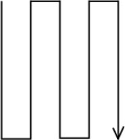
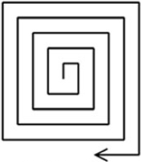
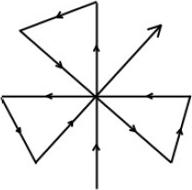
Subdivisions
Distribute the transceivers inside the established perimeter
Apply appropriate search pattern based on various factors
Fig. 7.1 Creeping Line
Fig. 7.2 Expanding Square
Fig. 7.3 Sector

Slide 8
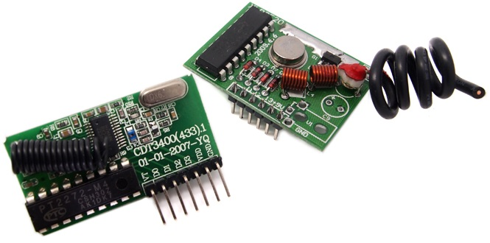
Transceiver Candidate
2KM Long Range RF link kits w encoder and decoder
47.5 x 30 x 10mm circuit board with 18cm antenna
Around $24 per unit
Can be modified to be jammable
Can be fitted with casing
Fig 8.1 Transceiver with 2km range offered on Seeed Studio

Slide 9

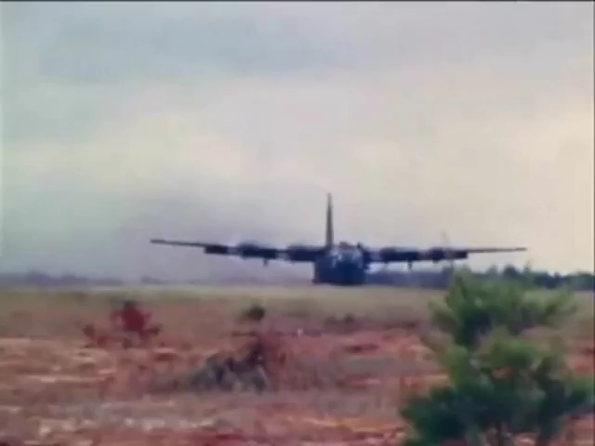
Aspirations
UAV Technology
GPS
Calling capability
Navigation to transceiver
Computerized distribution
Automated transceiver collection
Aircraft modifications
Above, LOCUST drone system
Below, modified C-130 used in Operation Credible Sport

Slide 10
Questions?

Slide 11
Thank you!

Slide 12
References
Damanis, G. (2014, March 18). Inside the US Coast Guard’s SAR Response to a Plane Crash. Retrieved February 21, 2017, from http://www.nycaviation.com/2014/03/inside-us-coast-guards-sar-response-plane-crash/
Figures 7.1, 7.2 and 7.3
2KM Long Range RF link kits w encoder and decoder. (n.d.). Retrieved February 21, 2017, from https://www.seeedstudio.com/2KM-Long-Range--RF-link-kits-w-encoder-and-decoder-p-321.html
Figure 8.1

Slide 13
References
[Office of Naval Research, U.S. Navy]. (2016, May 24). LOCUST - Swarming Navy Drones. [Video File]. Retrieved from https://www.youtube.com/watch?v=AIgTzduM7ZU.
[1415w]. (2006, Nov 05). Operation Credible Sport. [Video File]. Retrieved from https://www.youtube.com/watch?v=etzqmtYcpCQ.

